Slide 1
Lecture 4
Algorithm Analysis
Arne Kutzner
Hanyang University / Seoul Korea

Slide 2
Quicksort

Slide 3
Highlights
Worst-case running time: Θ(n²).
Expected running time: Θ(n lg n).
Constants hidden in Θ(n lg n) are small.
Sorts in place.
Algorithm Analysis
L3.<number>

Slide 4
Divide and Conquer Strategy with Quicksort
Divide: Partition A[p . . r ], into two (possibly empty) subarrays A[p . . q − 1] and A[q + 1 . . r ], such that each element in the first subarray A[p . . q − 1] is ≤ A[q] and A[q] is ≤ each element in the second subarray A[q + 1 . . r ]
Conquer: Sort the two subarrays by recursive calls to QUICKSORT
Combine: No work is needed to combine the subarrays, because they are sorted in place.
Algorithm Analysis
L3.<number>

Slide 5
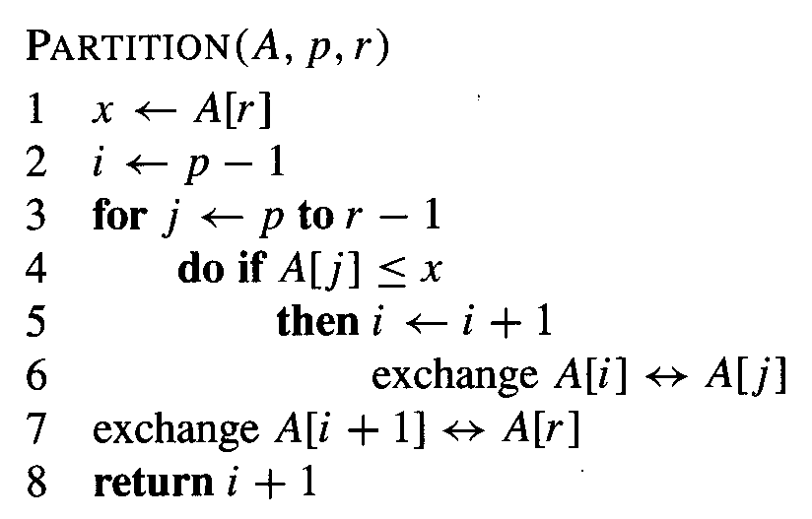
Pseudocode Partition
Algorithm Analysis
L3.<number>

Slide 6
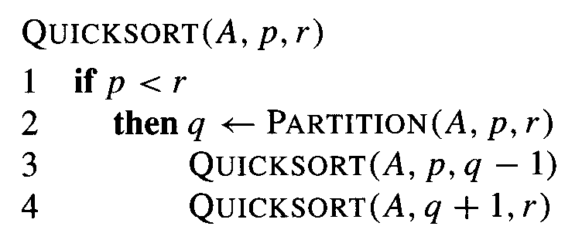
Pseudocode Algorithm
Algorithm Analysis
L3.<number>

Slide 7
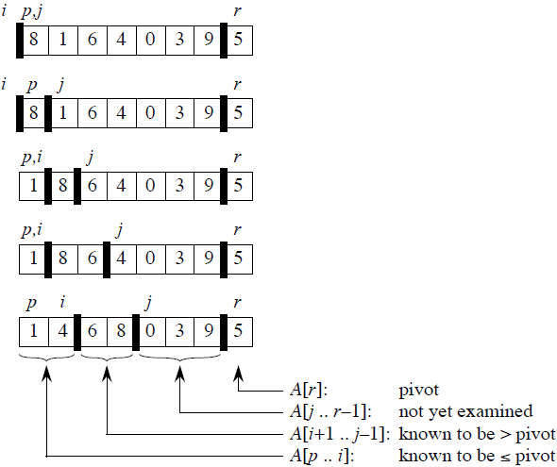
Creation of Partitions
(Divide Step)
Loop invariant:
1. All entries in A[p . . i ] are ≤ pivot.
2. All entries in A[i + 1 . . j − 1] are > pivot.
3. A[r ] = pivot.
Algorithm Analysis
L3.<number>

Slide 8
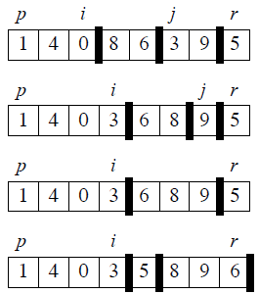
Creation of Partitions
(Divide Step)
Time for partitioning:
Θ(n) to partition an n-element subarray.
left recursive call
right recursive call
Algorithm Analysis
L3.<number>

Slide 9
Correctness of Partition
Initialization: Before the loop starts, all the conditions of the loop invariant are satisfied, because r is the pivot and the subarrays A[p . . i ] and A[i +1 . . j −1] are empty.
Maintenance: While the loop is running, if A[ j ] ≤ pivot, then A[ j ] and A[i +1] are swapped and then i and j are incremented. If A[ j ] > pivot, then increment only j .
Termination: When the loop terminates, j = r , so all elements in A are partitioned into one of the three cases: A[p . . i ] ≤ pivot, A[i + 1 . . r − 1] > pivot, and A[r ] = pivot.
Algorithm Analysis
L3.<number>

Slide 10
Worst-Case (intuitive)
Occurs when the subarrays are completely unbalanced.
Have 0 elements in one subarray and
n − 1 elements in the other subarray.
Get the recurrence
T(n) = T (n − 1) + T (0) + Θ(n)
= T (n − 1) + Θ(n)
= Θ(n²)
Algorithm Analysis
L3.<number>

Slide 11
Best Case (intuitive)
Occurs when the subarrays are completely balanced every time.
Each subarray has ≤ n/2 elements.
Get the recurrence
T(n) = 2T(n/2) + Θ(n)
= Θ(n lg n)
Algorithm Analysis
L3.<number>

Slide 12
Balanced Partitioning
Quicksort’s average running time is much closer to the best case than to the worst case.
Imagine that PARTITION always produces a 9-to-1 split.
  Get the recurrence
  T(n) ≤ T(9n/10) + T(n/10) + Θ(n)
  = O(n lg n)
Algorithm Analysis
L3.<number>

Slide 13
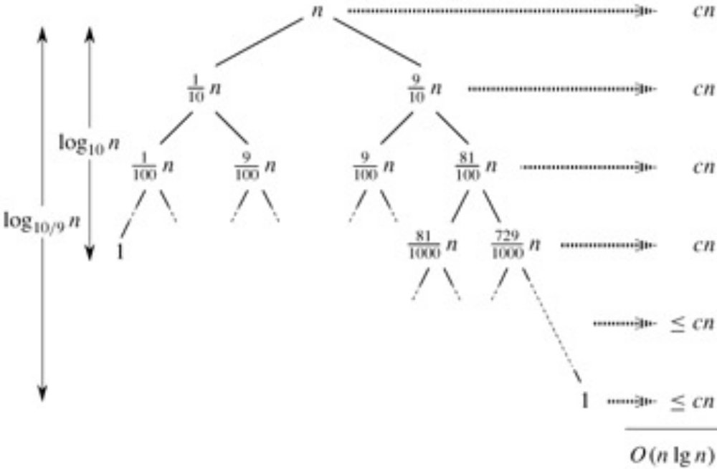
Balanced Partitioning (cont.)
full levels
longest path
Algorithm Analysis
L3.<number>

Slide 14
Average Case (Intuition)
Splits in the recursion tree will not always be constant.
There will usually be a mix of good and bad splits throughout the recursion tree.
To see that this doesn’t affect the asymptotic running time of quicksort, assume that levels alternate between best-case and worst-case splits.
Algorithm Analysis
L3.<number>

Slide 15
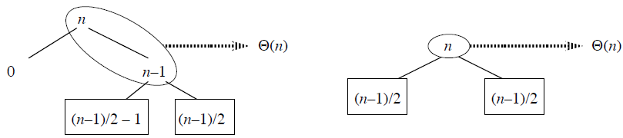
Average Case (Intuition)
The extra level in the left-hand figure only adds to the constant hidden in the notation.
There are still the same number of subarrays to sort, and only twice as much work was done to get to that point.
Algorithm Analysis
L3.<number>

Slide 16
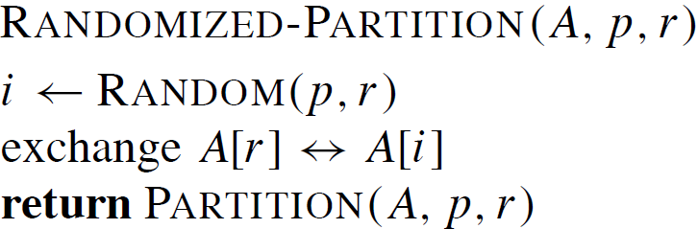
Randomized version of quicksort
We have assumed that all input permutations are equally likely.
This is not always true.
To correct this, we add randomization to quicksort.
Algorithm Analysis
L3.<number>

Slide 17
Average Case (Detailed)
The dominant cost of the algorithm is partitioning.
PARTITION removes the pivot element from future consideration each time. Thus, PARTITION is called at most n times.
The amount of work that each call to PARTITION does is a constant plus the number of comparisons that are performed in its for loop.
Let X = the total number of comparisons performed in all calls to PARTITION. So, total work done over the entire execution is O(n + X)..
Algorithm Analysis
L3.<number>

Slide 18
Average Case – Number of Comparisons
For ease of analysis:
Rename the elements of A as z₁, z₂, . . . , z_{n}, with z_{i} being the i th smallest element.
Define the set Z_{i j} = {z_{i} , z_{i+1}, . . . , z_{j} } to be the set of elements between z_{i} and z_{j} , inclusive.
Algorithm Analysis
L3.<number>

Slide 19
Average Case – Number of Comparisons (cont.)
Important:
Each pair of elements is compared at most once, because elements are compared only to the pivot element, and then the pivot element is never in any later call to PARTITION.
Let X_{ij} = I {z_{i} is compared to z_{j} }.
Algorithm Analysis
L3.<number>

Slide 20
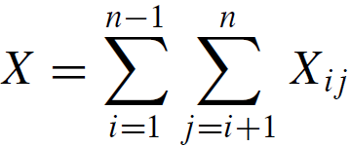
Average Case – Number of Comparisons (cont.)
Since each pair is compared at most once, the total number of comparisons performed by the algorithm is
Algorithm Analysis
L3.<number>

Slide 21
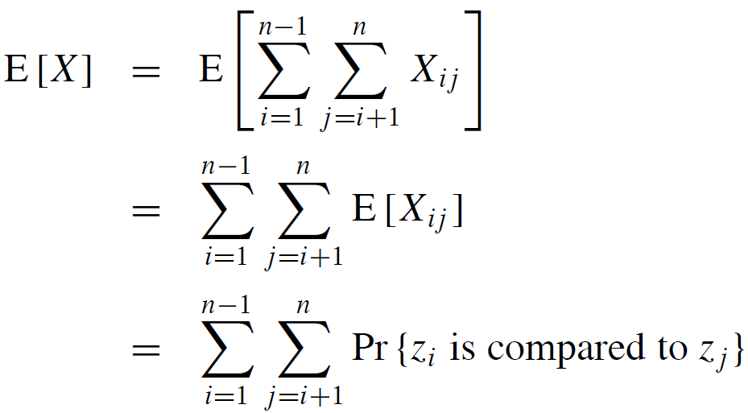
Average Case – Number of Comparisons (cont.)
Expectations of both sides:
Algorithm Analysis
L3.<number>

Slide 22
Average Case – Number of Comparisons (cont.)
Probability that two elements are compared:
Once a pivot x is chosen such that z_{i} < x < z_{j} , then z_{i} and z_{j} will never be compared at any later time.
If either z_{i} or z_{j} is chosen before any other element of Z_{ij} , then it will be compared to all the elements of Z_{ij}, except itself.
The probability that z_{i} is compared to z_{j} is the probability that either z_{i} or z_{j} is the first element chosen
Algorithm Analysis
L3.<number>

Slide 23
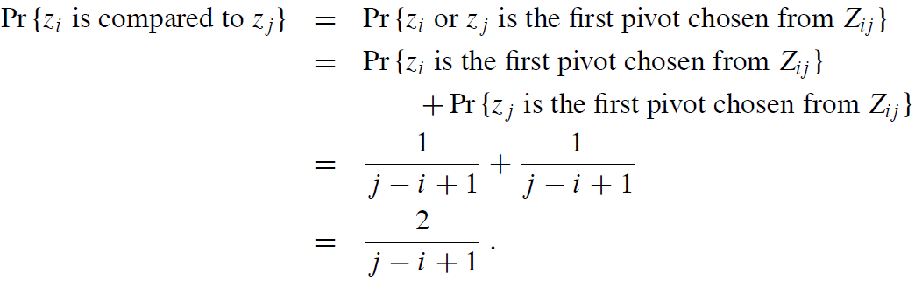
Average Case – Number of Comparisons (cont.)
There are j−i+1 elements, and pivots are chosen randomly and independently.
Thus, the probability that any particular one of them is the first one chosen is 1/( j − i + 1).
Algorithm Analysis
L3.<number>

Slide 24
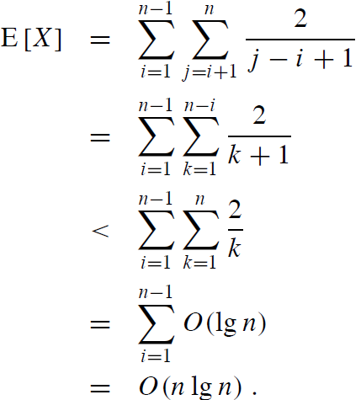
Average Case – Number of Comparisons (cont.)
simple transformation
approximation
Harmonic series
Algorithm Analysis
L3.<number>

